Slide 1
Policy and Project Trends in Economic Development
Christopher D. Lloyd, SVP and Director, Infrastructure and Economic Development
Southern Municipal Conference - October 23, 2025

Slide 2
RETURN TO OFFICE IS REAL

Slide 3
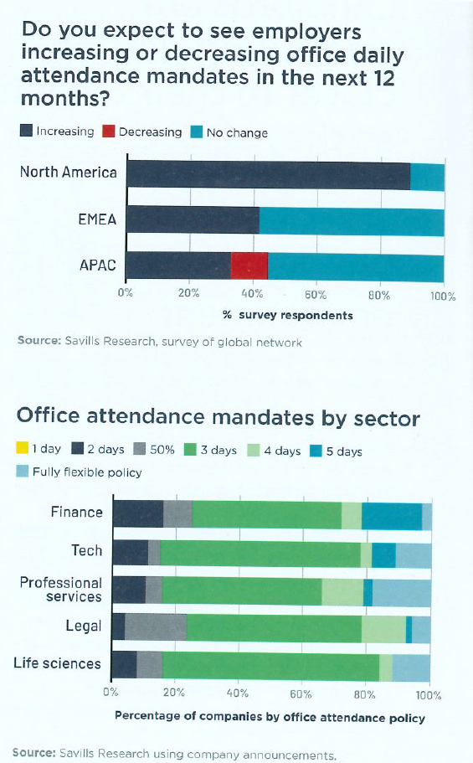

Slide 4
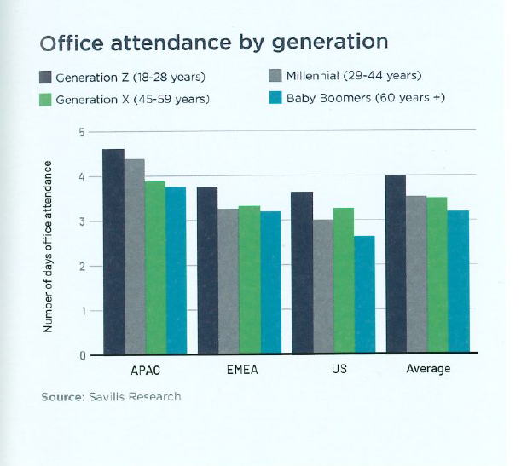

Slide 5
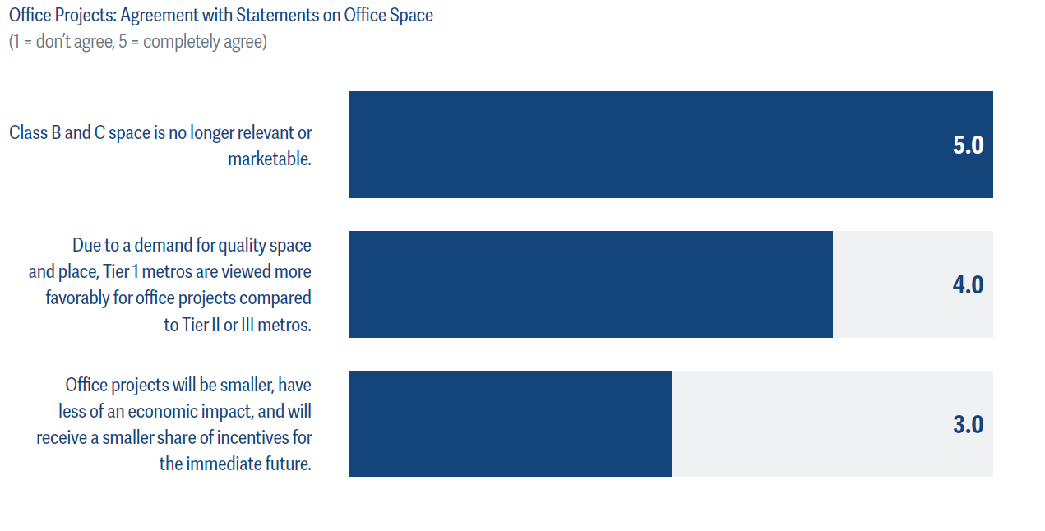

Slide 6
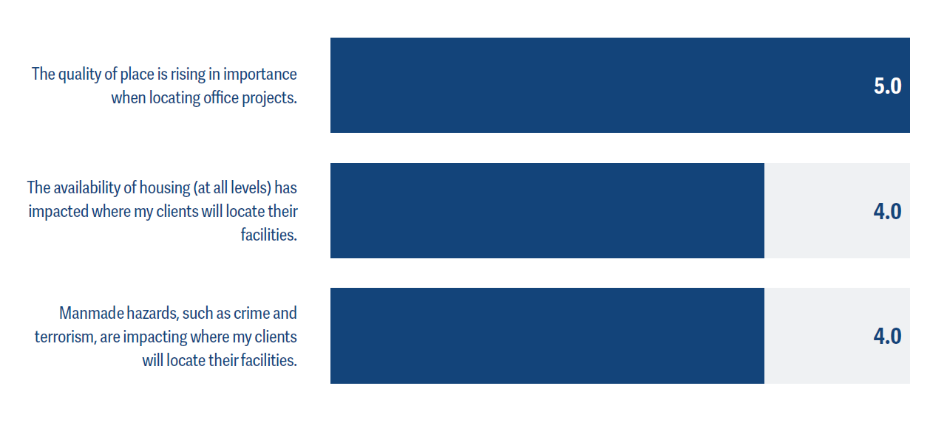

Slide 7
Winning Strategies
Convert, redevelop, or demolish older office buildings – tax incentives/TIF, flexible zoning, accelerated permitting
Reassess parking requirements
Be prepared for the fiscal downside and upsides when property reassessments occur
Investments in quality of life/quality of place MATTER
Develop a strategy to enhance development of workforce housing

Slide 8
UNCERTAINTY IS THE NEW REALITY

Slide 9
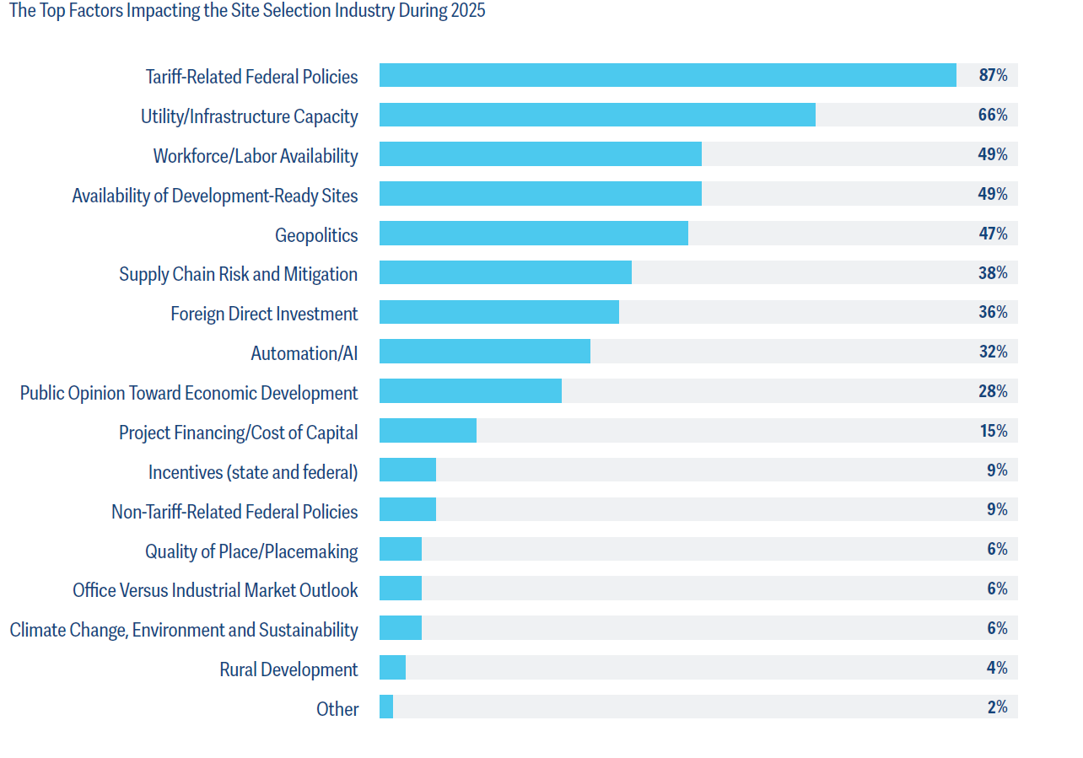

Slide 10
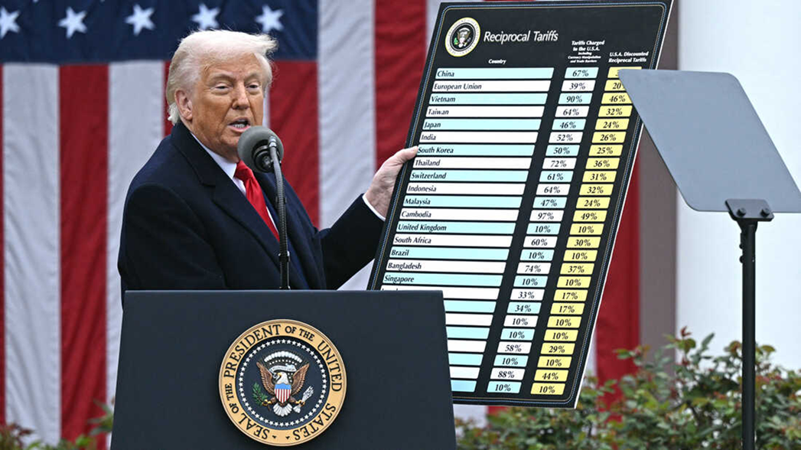

Slide 11
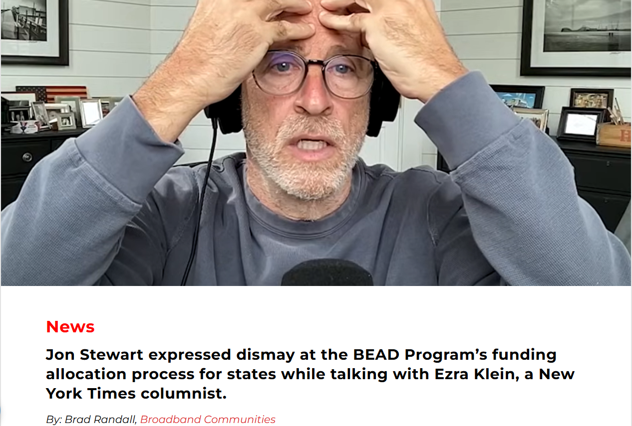

Slide 12
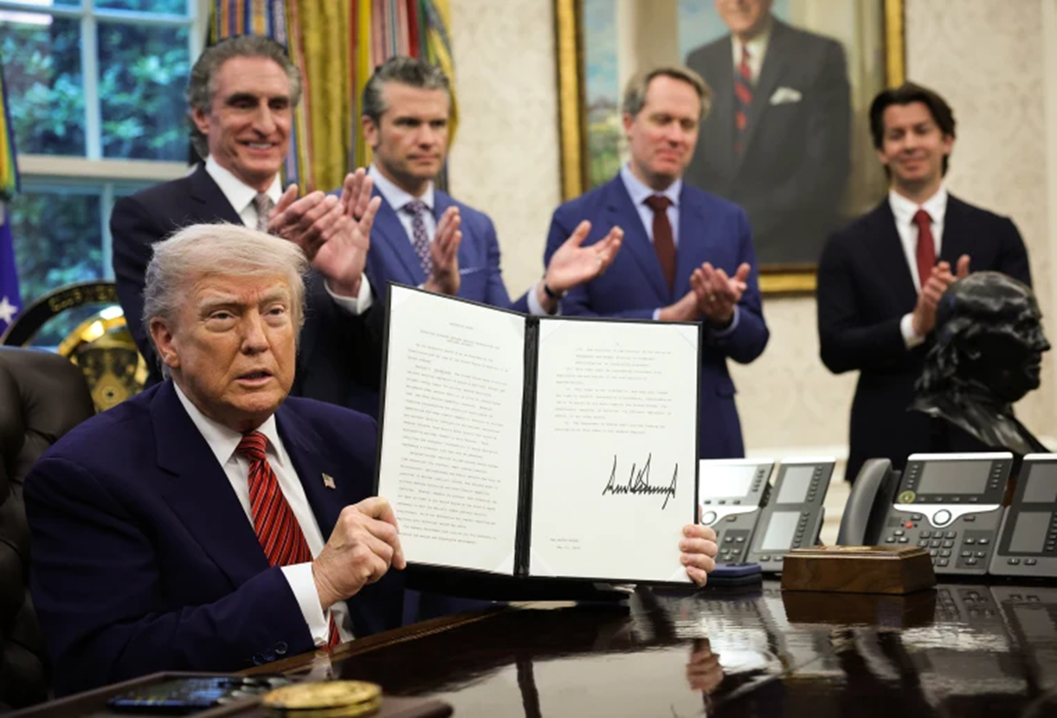

Slide 13

Executive Orders
Executive Order 14264 – Maintaining Acceptable Water Pressure in Showerheads
“I like to take a nice shower to take care of my beautiful hair,” President Donald Trump said upon signing the order. “I stand under the shower for 15 minutes until it gets wet. It comes out drip, drip, drip. It’s ridiculous.”

Slide 14
Executive Orders with Economic Development Opportunities
Executive Order 14179 – Removing Barriers to American Leadership in Artificial Intelligence
Executive Order 14278 – Preparing Americans for High-Paying Skilled Trade Jobs of the Future – expand apprenticeships and streamline/align federal workforce training programs
Executive Order 14269 – Restoring America’s Maritime Dominance – invest in maritime industrial base and block Chinese shipping
Executive Order 14255 – Establishing the United States Investment Accelerator – orders federal agencies to speed permits for economic development projects valued at over $1 billion
Executive Order 14307 – Unleashing American Drone Dominance – promote domestic UAV and eVTOL production and reduce regulatory barriers
Executive Order 14304 – Leading the World in Supersonic Flight – regulatory reform and increased R&D investment
Executive Order 14302 – Reinvigorating the Nuclear Industrial Base – regulatory reform, workforce investment, and accelerate plant construction

Slide 15
Winning Strategies
Become a beacon of stability – streamline and fast track permitting and approval processes, fiscal prudence
Monitor federal notices for PPP opportunities stemming from EOs
Optimize FTZ/freeport exemptions/bonded warehouses to mitigate tariff impacts
Engage with state and federal partners on how to benefit from the “new order”
Host seminars/workshops on OBBBA, executive orders so your business community can benefit from pro-growth policies

Slide 16
CAPITAL INVESTMENT IS BOOMING

Slide 17
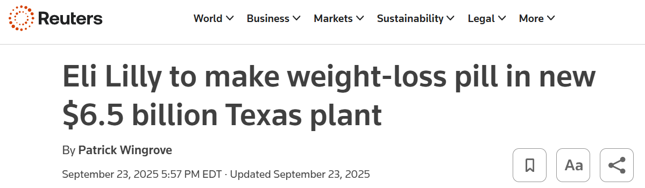
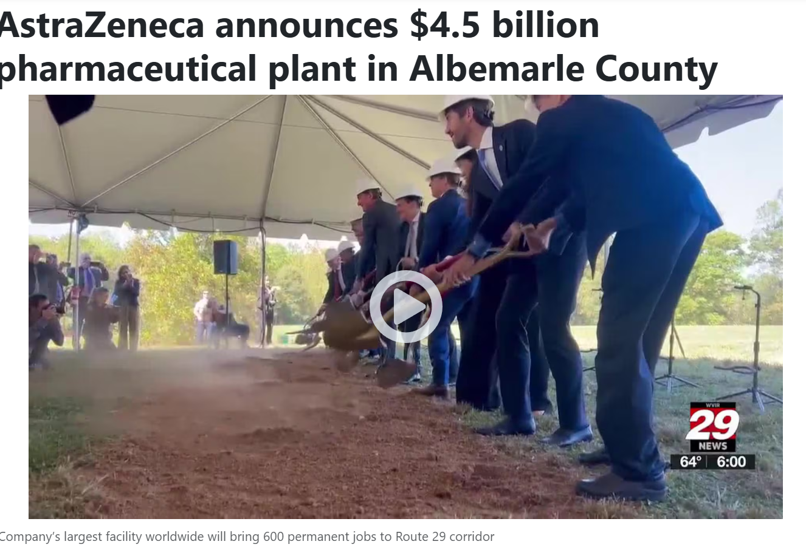

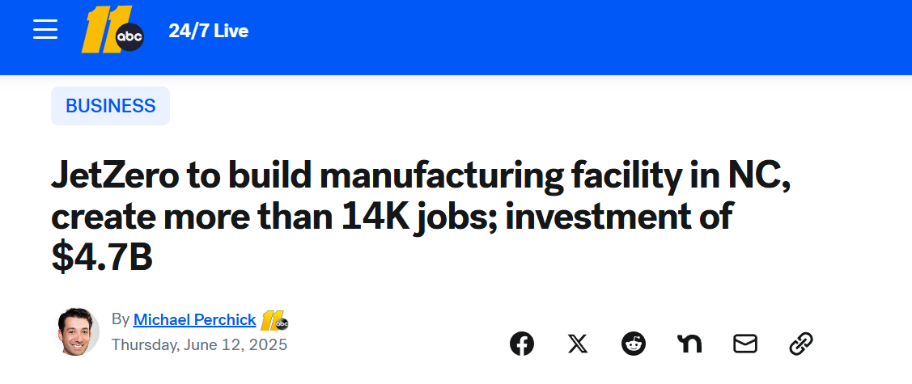

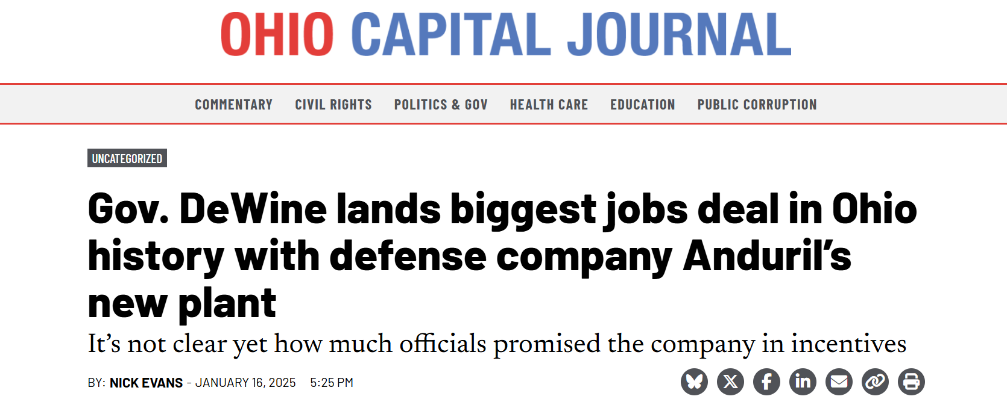
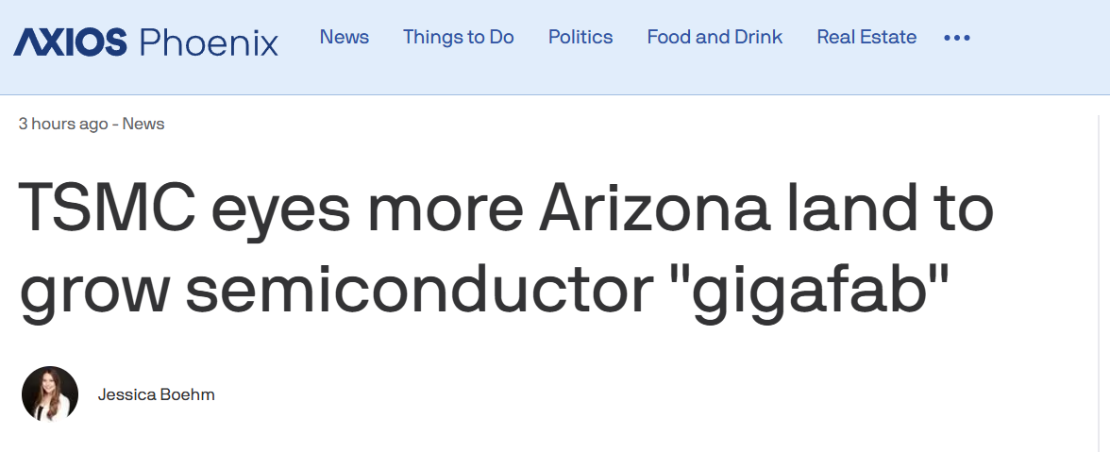


Slide 18
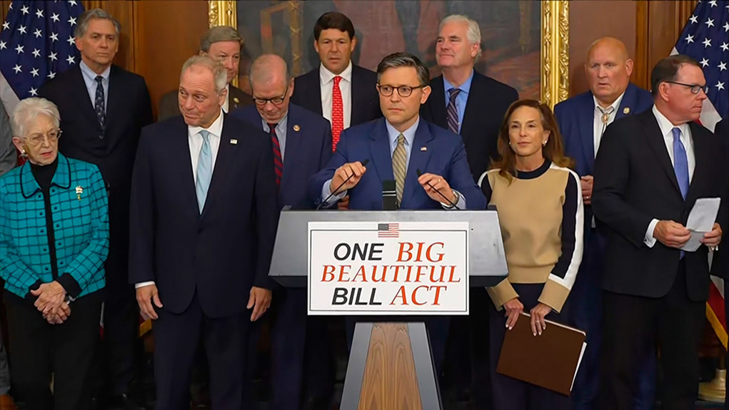

Slide 19
Taxes – Pro-Growth Provisions
Immediate expensing of capital investment, even for real property through 2029
Increase R&D deductions
Enhanced deductibility of corporate debt
Opportunity Zone enhancements (with special emphasis on rural America)

Slide 20
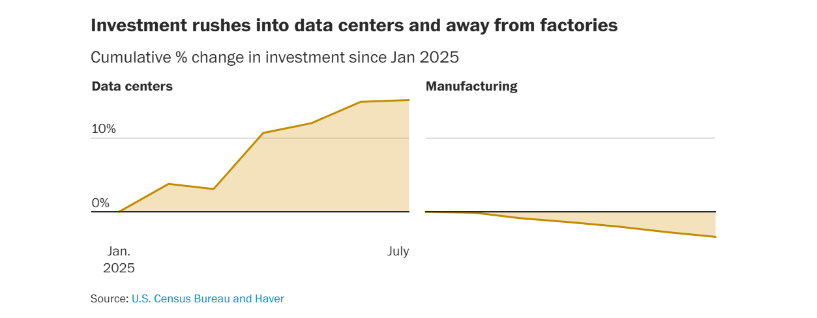

Slide 21
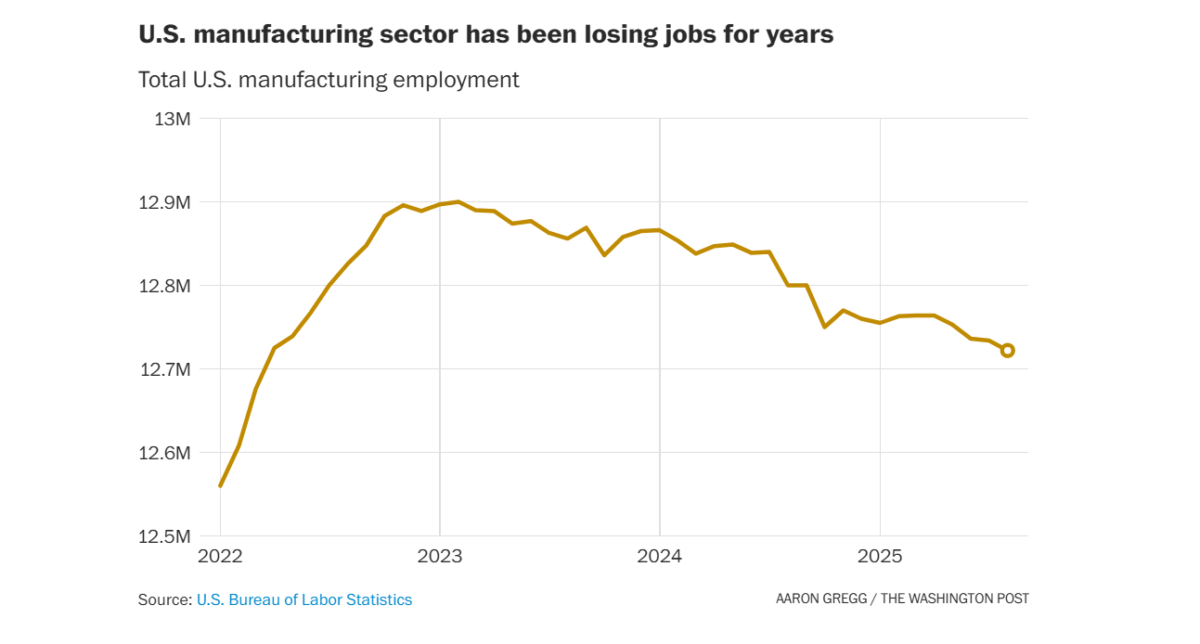

Slide 22
Winning Strategies
Regulatory streamlining and fast track permitting
Invest in shovel ready site development
Ensure you have the inspection staff on board with capabilities to approve these projects
Have a program that courts business retention/expansion, not just attraction
Assess current utility capabilities and what enhancements may be necessary
Advance identification of ROW corridors (and acquire if possible)
Review how you tax capital assets to ensure that structure does not disincentivize capital investment
Invest in developing talent pipeline to fill new jobs

Slide 23
AND DATA CENTERS/AI ARE DRIVING THAT BOOM

Slide 24
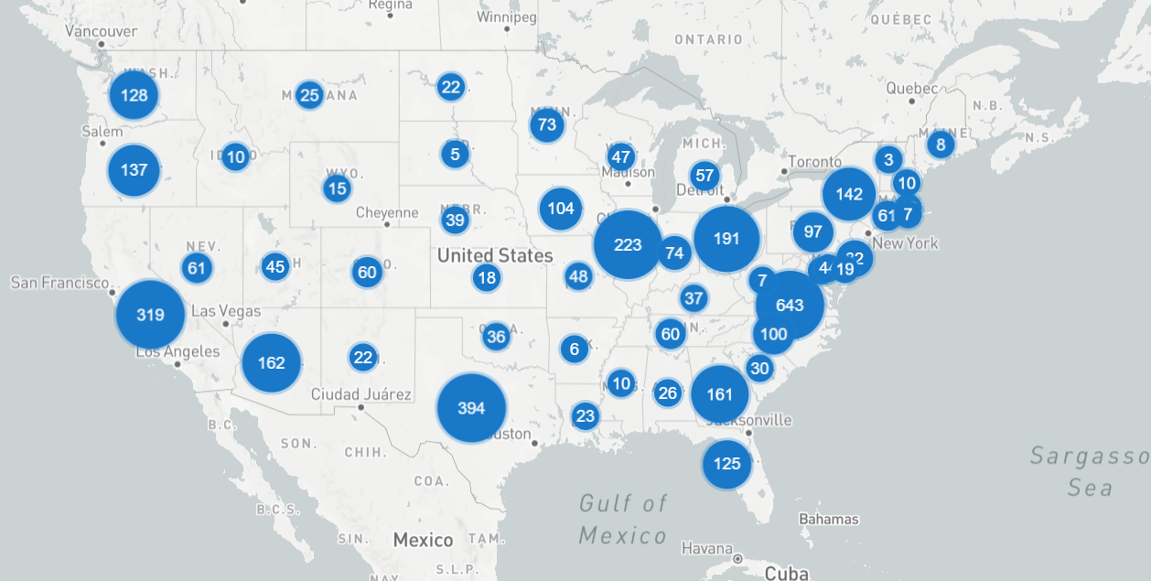

Slide 25
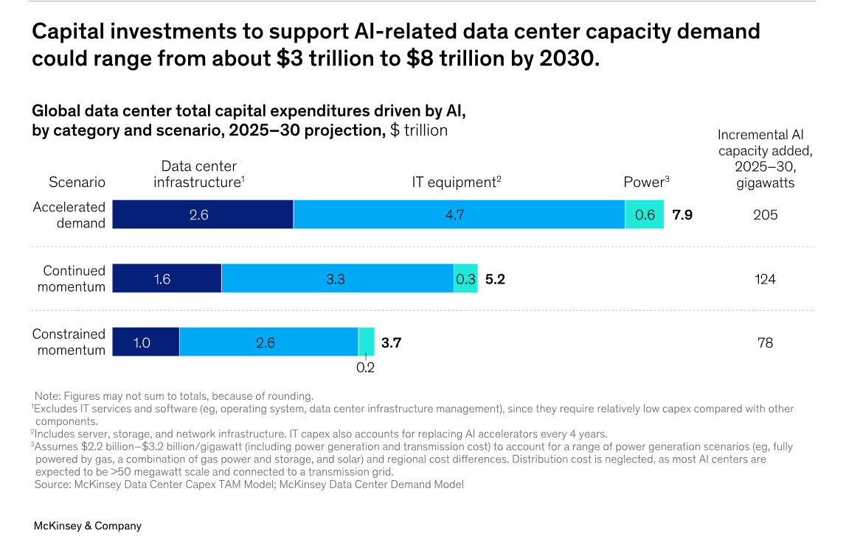

Slide 26
Winning Strategies
Determine whether your community wants data centers
Develop a data center development strategy that includes land use/noise/taxation/sustainability provisions
Assess the capabilities of your utility system to handle data center needs
Identify how data center generated tax revenues will be used by the community to meet public needs

Slide 27
CHEAP POWER IS DEAD*

Slide 28
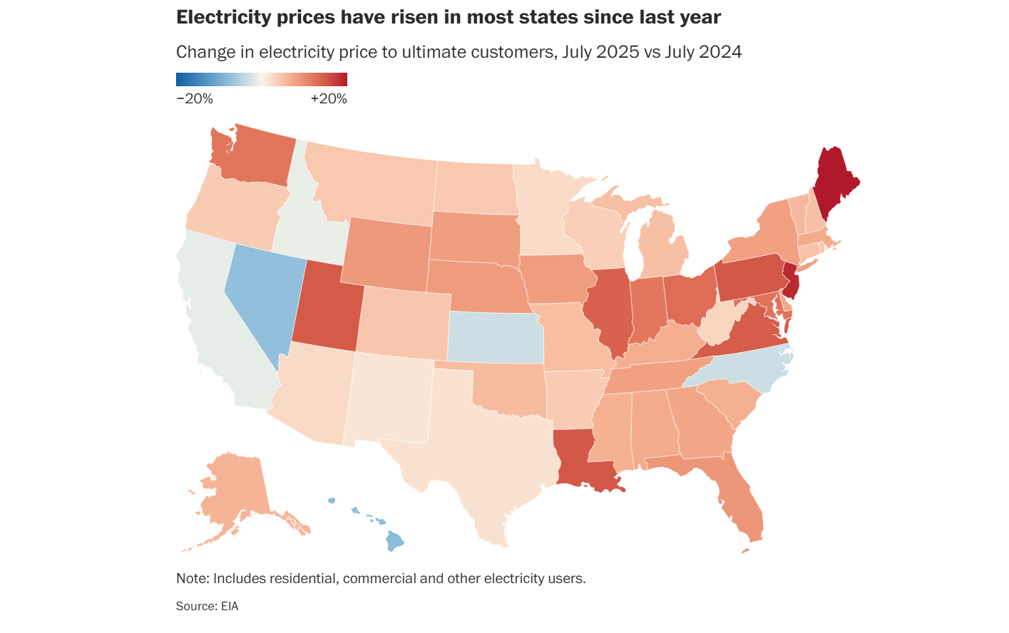

Slide 29

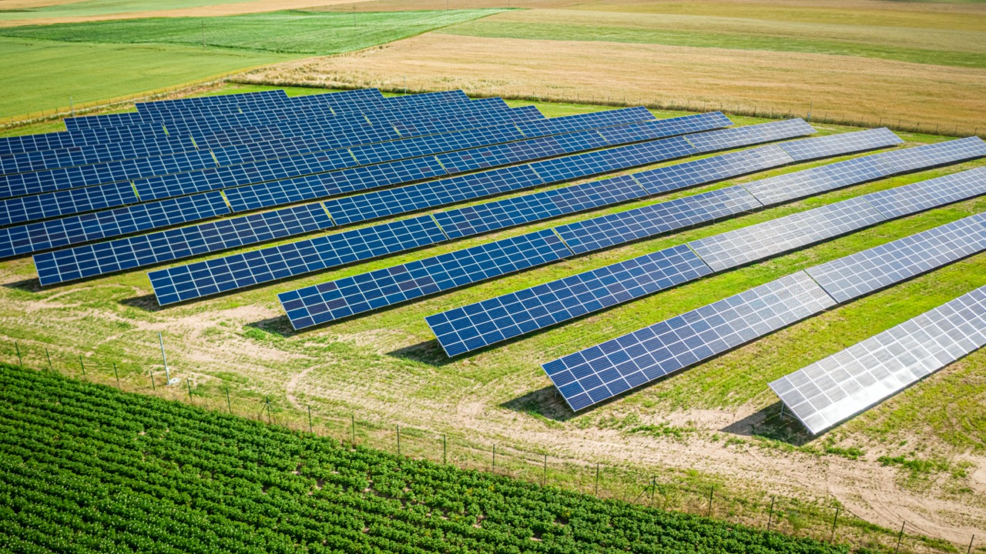

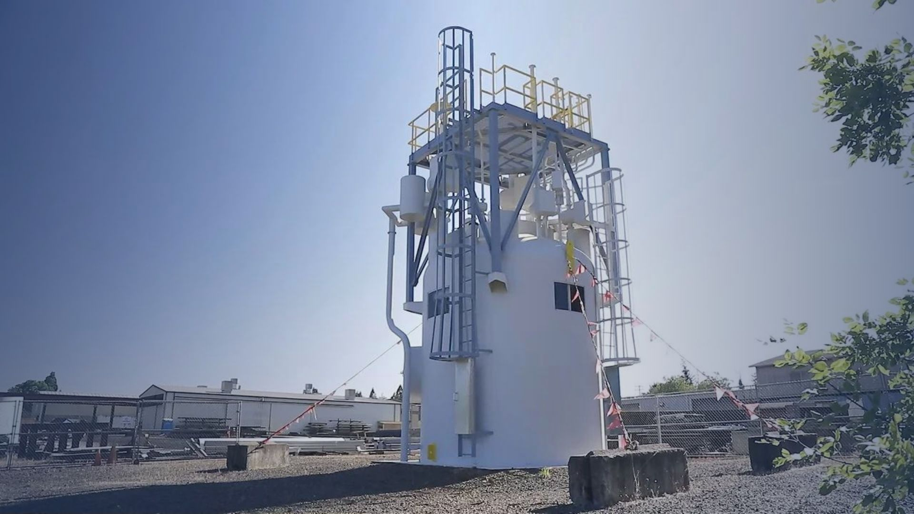


Slide 30
Winning Strategies
Assess which new energy sources are a good fit for your community and build consensus
Designate “energy ready” sites
Regulatory streamlining and fast track permitting
Review tax treatment of facilities and how you can incentivize
Foster educational partnerships to build the energy workforce
Support university R&D collaborations

Slide 31
NIMBYISM IS EVERYWHERE

Slide 32
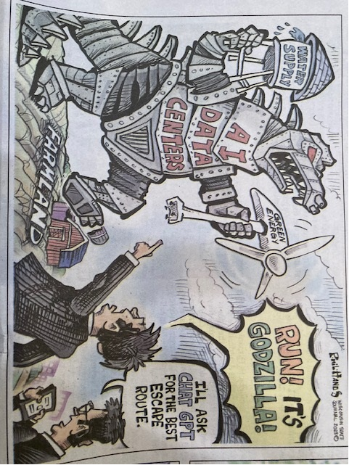

Slide 33
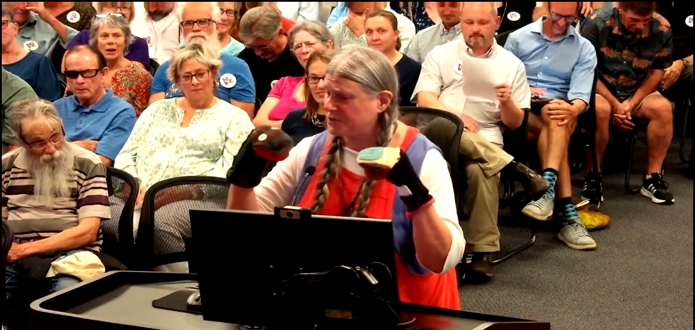

Slide 34
Winning Strategies
Educate, educate, educate
Engage with the public early and often
Identify political champions for growth/economic development
Polling of community to test sentiment, messages
Thoughtfully plan where you want development to occur (or not occur)
Identify uses of revenue to be generated by new development

Slide 35
Questions or Comments?

